Slide 1
FUNDER FOCUS: National Science Foundation
August 28, 2023
Office of Research & Economic Development
Slides from NSF’s June 2023 Virtual Grants Conference

Slide 2
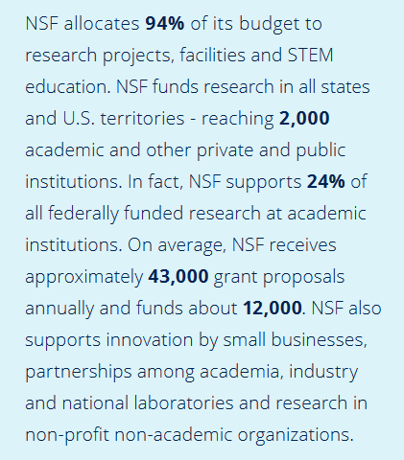
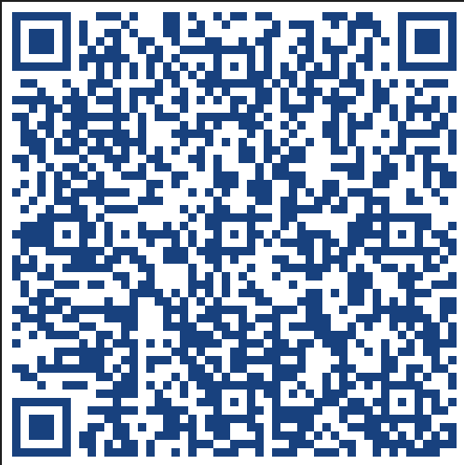
Agency Overview
Functions
Organization
Support and Funding Rates
Strategic Plan
Mission/Vision/Core Values
Highlights of New Initiatives
Resources

Slide 9
NSF Strategic Plan for 2022-2026

Slide 10
The Mission of the National Science Foundation is to promote the progress of science, to advance the national health, prosperity and welfare, to secure the national defense; and for other purposes.
Opportunities and Grand Challenges
Accelerating Impact and Knowledge Mobilization
Global Engagement
Knowledge-intensive Industries (and demand for STEM Talent)
Including the “Missing Millions”
The Discovery Engine – leveraging partnerships with other sectors

Slide 11
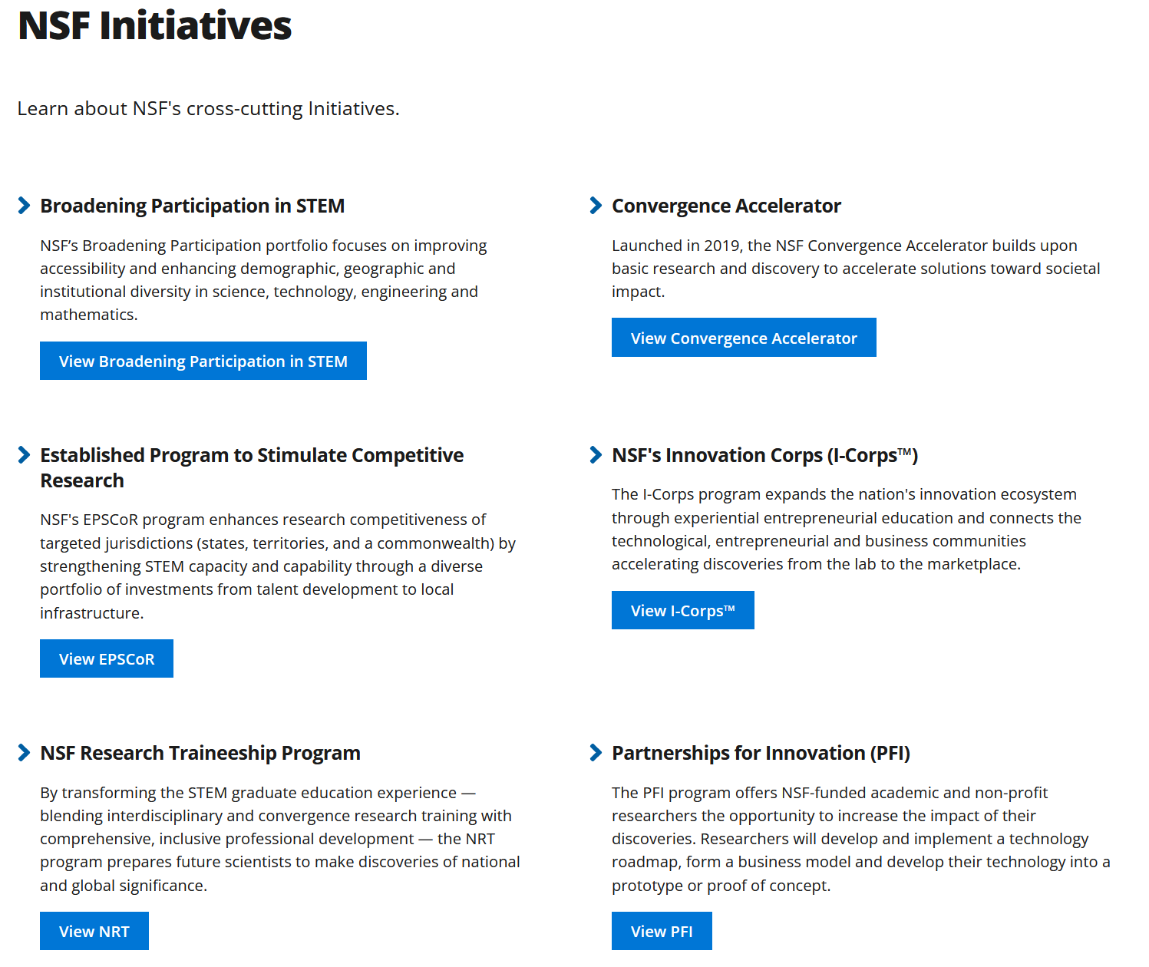
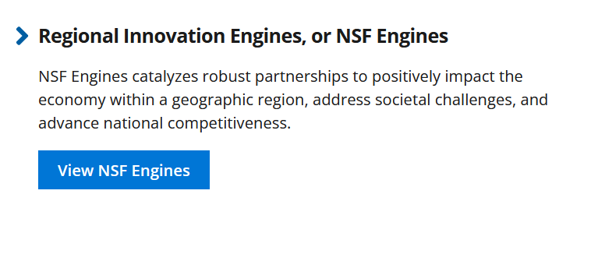

Slide 12
