Slide 1
Broader Impacts: Advancing Research impact in society
ORED Seminar Series
November 10, 2021

Slide 2
What do we mean by Broader Impacts?
“Broader Impacts” is a term most recognizable by the academic and research community as an element of review criteria established by the National Science Foundation.
In today’s broader research funding landscape, this term has come to define a project's ability to leverage broad and diverse resources to affect change or create non-academic benefits to a specific audience or sector of society.
Today, we’ll review:
Quick history and evolution of “Broader Impacts”
Some types of Impact
Tips for demonstrating impact in your proposal
Your “Broader Impacts” identity
Additional resources to support impact planning, demonstration, and evaluation

Slide 3
If the concept of impact has relevance only because of an NSF instruction, then the potential for success of your proposal is diminished.
Portions of today’s presentation are made available through ARIS (Advancing Research Impact in Society) through support from the National Science Foundation under grants OIA-1810732 and MCB-1408736.

Slide 4
NSF Merit Review Criteria
“…to promote the progress of science; to advance the national health, prosperity, and welfare; to secure the national defense; and for other purposes.” – NSF Mission
Intellectual Merit – the potential to advance scientific knowledge (creative, original, potentially transformative)
Broader Impact(s) – the potential to benefit society and contribution to the achievement of specific, desired societal outcomes.
NSF wants to know, “what is the potential for the proposed activity to:
a. advance knowledge and understanding within its own field or across different fields (Intellectual Merit); and
b. benefit society or advance desired* societal outcomes (Broader Impacts)?”
*These desired outcomes are what you have to establish (are they aligned with the funder’s desired outcomes?), justify, and demonstrate may be achieved through your project.

Slide 5
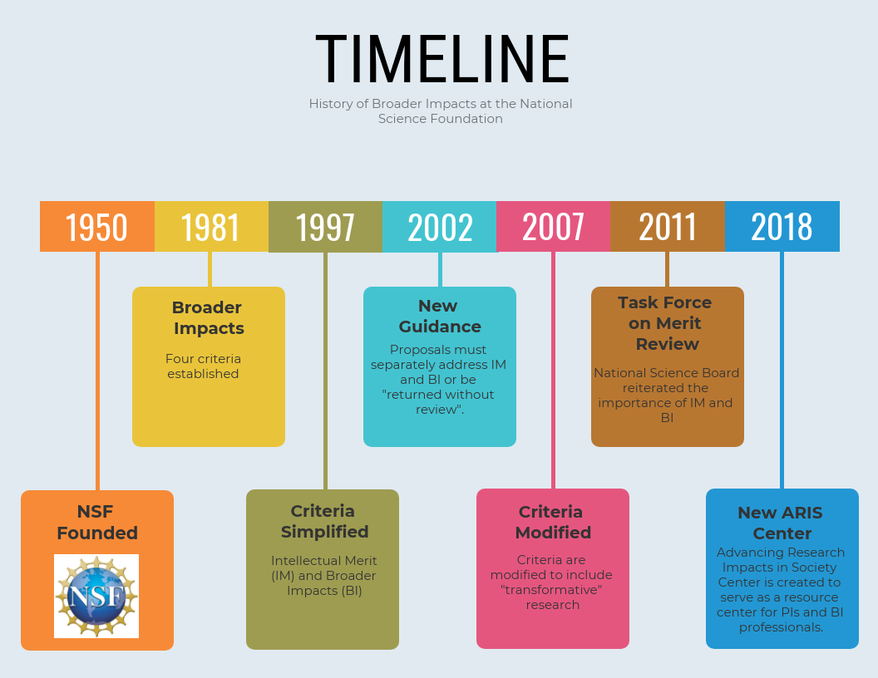
ARIS | © 2020 ARIS, all rights reserved. This work is supported by the National Science Foundation under grants OIA-1810732 and MCB-1408736.
2/19/21
Notes:
Although NSF revised, refined and clarified its review criteria over the years, it appears that broader impacts were considered from at least the 1960s. It did not, however, become a separate and distinct criterion until 1997, when NSF simplified the merit review criteria for proposals from four to two—intellectual merit and broader impacts. In 2007, NSF further clarified these two criteria to emphasize transformative research.
Currently – PI must have BI and IM clearly sub-headed and labeled in their proposals.
ARIS (2018) is the first “center” funded by NSF to advance BI among scientists and engineers.

Slide 6
Broader Impacts: Just the NSF? For now…
6

Slide 7
Separating Intellectual Merit from Broader Impacts
IM asks what are the original contributions of the proposed work to the area of study.
A common critique is that PIs are too vague as to originality, creativity, and potentially transformative nature of the work they propose.
How would this work potentially change the direction of or challenge conventional wisdom in the field?
What new knowledge or contribution doe the proposed work bring to the discipline’s body of knowledge?
IM may be narrow…and that is OK! IM is NOT about novelty or experience of the investigator, e.g., “I bring a strong mathematics background to this predominantly engineering research team,” or “Not having to teach would allow for more progress toward this goal.”
Broader Impacts is where you will describe any potential the proposed research and accompanying activities have to produce impact beyond the discipline.

Slide 8
NSF’s Broader Impacts Criteria
For NSF proposals, your Broader Impacts activities and performance measures are those elements which target and/or engage a specific audience or beneficiary and:
Potential to advance discovery and understanding while promoting teaching, training, and learning;
Potential to actively promote broadening participation* and engagement among underrepresented groups;
Enhance infrastructure for research and education, such as facilities, instrumentation, networks and partnerships;
Ensure broad dissemination of the results of the work funded to enhance scientific and technical understanding.
*“Broadening Participation” and “Broader Impacts” are NOT the same thing!

Slide 9
Improved well-being of individuals in society
BROADER
Increased economic competitiveness of the US
IMPACTS
Improved national security
Increased public STEM literacy and public engagement with STEM
BROADENING PARTICIPATION
Full participation of women, persons with disabilities and underrepresented minorities in STEM
Improved STEM education and educator development (any level)
Development of a diverse, globally competitive STEM workforce
Enhanced infrastructure for research and education
Increased partnerships between academia, industry, and others

Slide 10
Why does broad participation matter?
We need the best and brightest in STEM. If we’re not drawing from the ENTIRE population, we’re potentially missing out on a lot of great minds
We need to have all voices at the table to ensure we’re asking the questions that affect everyone
To ensure equity with respect to funding decisions
It’s the right thing to do!

Slide 11
Why Do
Broader Impacts Matter?

Slide 12
Beyond NSF: How does your research impact society?
Scientists and engineers funded by the U.S. National Science Foundation are accountable to taxpayers for conducting research, and collectively moving their research beyond the lab to impact the public good, thereby benefitting the economy, society and discovery itself. This is why demonstrating “Impact” is a focus and often requirement of many federal and other funders.
The “Impact Chain”
Fundamental Knowledge
New Knowledge
Knowledge Sharing
Societal Impact
Information, data, findings, evidence, anecdotes, methods
Publications, presentations, collaborations, partnerships, workshops, reports, conferences
Practices, policy formation, decision-making models, innovation, quality of life, innovation

Slide 13
Some Examples of Impact
Social & Cultural Impacts
Improved quality of life
Improved personal/public/national safety & security
Reduced poverty
Improved education, literacy, opportunity, health, access to social services
Improved cultural health, societal participation
Decreased marginalization
Improved models for decision-making & risk management
Environmental Impacts
Improved quality of air, water, land, soil, species, ecosystems, environmental management & stewardship, sustainability
Renewable, sustainable, safe energy
Increased agricultural productivity & safe food supply
Speed of recovery from environmental problems
Mitigation of risk to environment
Economic Impacts
GDP growth
Increased employment, jobs, and exports
New technologies, products, patents, licenses, companies, jobs
Increased industry competitiveness & market leadership
Increased productivity, income & revenue
Production efficiency & cost reduction
Private sector investment
Health Impacts*
Reduction of disease & mortality rates
Improved clinical outcomes
Reduction of healthcare costs
Treatment efficacy
Improved patient satisfaction, quality of life
Improved surgical techniques, treatments, therapies
Increased preventative therapies

Slide 14
IMPACT suggests a long-term change.
IMPACT is achieved through ACTIVITIES and is demonstrated by OUTCOMES, which must be MEASURABLE
Examples of Impact Outcomes include, but are not limited to:
full participation of women, persons with disabilities, and underrepresented minorities in (STEM)*;
improved STEM education and educator development at any level;
increased public scientific literacy and public engagement with science and technology;
improved well-being of individuals in a sub-segment of society;
development of a diverse, globally competitive STEM workforce;
increased partnerships between academia, industry, and others;
enhanced national security;
increased economic competitiveness of the United States; and
enhanced infrastructure for research and education.
*These are NSF-specific, but remember, impact applies to ALL types of efforts to bring about a change – includes arts, humanities, education, health, workforce, social sciences, etc.

Slide 15
Why do Broader Impacts matter?
Accountability is a good thing
Forces researchers to think more deeply about the relevance and implications of their work
Reinforces/strengthens communication skills
Engages and excites next generation of scientists and engineers
Increases diversity in STEM

Slide 16
Demonstrating
Broader Impact in Your Proposal

Slide 17
Broader Impacts may be achieved through the research itself, through activities that are directly related to specific research projects, or through activities that are supported by, but are complementary to, the project.
Impact activities typically include:
Impact Planning (identifying, analyzing, mapping, prioritizing types and audience)
Education and outreach initiatives (format unique to audience and type of research)
Partnerships and stakeholder engagement/co-creation (consider all types of collaborators, partners, beneficiaries and their possible role)
Infrastructure access and support (both tangible and alignment with institutional/investigator capacity)
Knowledge mobilization (includes dissemination, translation, transfer, exchange)
Impact tracking and evaluation (evidence base for metrics, activities for follow up/measurement)

Slide 18
Broader Impacts: Example Activities:
Advance discovery while promoting teaching and learning…
developing research-based educational materials or contribute to databases useful in teaching (ex: digital libraries, resource materials for teachers, community activities)
Piloting new methodologies and activities with students; curriculum design involving team- or project-based learning
Partnering with researchers and educators to develop effective means of incorporating research into learning and education (MSU’s on teams in education research, curriculum and instruction, or workforce development, for example)
Encouraging student participation at meetings and activities of professional societies
Broaden participation of underrepresented groups….
Partner with established programs at MSU (ACCESS, TRIO, funded BP programs, affinity/professional orgs.etc.)
Make campus visits and presentations at institutions that serve underrepresented groups
Establish research & education partnerships and collaborations with faculty and students at community colleges, HBCUs, PUIs, MSIs, and EPSCoR institutions
REUs, RETs, student exchanges, “citizen science” and experiential learning and research activities
Mentor early-career scientists from underrepresented groups in growth areas (not just the discipline, but the work of academia including proposal preparation, technology transfer, navigating life as new faculty, etc.)

Slide 19
Broader Impacts: Ways to…..
Benefit society…
Build on other efforts of your professional and academic organizations –leverage their impact
Demonstrate a linkage between discovery and societal benefit through impact planning exploration
Partner with academic scientists, staff, at federal agencies and with private sector to integrate research into broader programs and activities of NATIONAL interest (NGOs, “think tanks,” etc.)
Analyze, interpret, and synthesize research and education results in formats understandable and useful for non-scientific audiences/ knowledge translation
Disseminate to enhance scientific and technological understanding…
Integrate research with education activities to communicate a broader context
Partner with museums, nature/science centers and the like, to develop exhibits in STEM, etc.; host events
Present research and education results in formats useful to policy makers and in their environments
Translate research into complementary fields via conference presentations across disciplines and among beneficiary populations

Slide 20
Where does BI appear in my NSF proposal?
Project Summary & Abstract
Project Description: “Broader Impacts of the Proposed Work”
Special Information and Supplementary Documentation
Postdoc Mentoring Plan
Data Management Plan
Letters of Collaboration
Biosketch
Budget & Justification
Annual Report

Slide 21
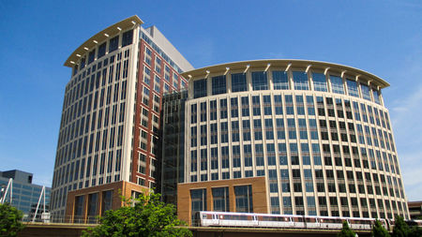
NSF program officer:
“
The BEST broader impacts plans are seamlessly integrated into the research
”

Slide 22
In NSF and other proposals, BI may be integrated throughout a proposal by…
Setting specific IMPACT goals and objectives
Statistics and references (justification and baseline for impact performance indicators)
Using the “chain” concept
Proactive language (“will” not “should” or “might”)
Specificity - provide detail about proposed activities (support with collaborator commitment if possible)
Direct v. indirect impacts
Timeframes and deliverables
Clearly defined roles of researchers, partners, and collaborators (and students/other education beneficiaries)
Describe institutional support (of applicant and stakeholders)
Bios and C&P by demonstrating established relationship, where applicable
Budget by demonstrating devoted resources

Slide 23
Broader Impacts
Resources

Slide 24
BI Resources At/Near MSU
Office of Research Development (our website has resources, and we can find others!)
Center for Community Engaged Learning
MS Cooperative Extension; 4H; FFA
MSU’s Centers and Institutes
Undergraduate Research Office – REUs, MARC, etc.
Evaluation: SSRC; RCU; NSPARC
Office of Institutional Diversity and Inclusion; disability resource center
Local museums, science/technology centers, zoos, aquaria, nature centers, etc.
Local schools, after-school programs; STEM summer camps
Office of Student Affairs/Student Activities (MVC)
Greater Starkville Development Partnership
Local Science Cafés; Farmers Markets; County Fairs
Local senior centers, scouting groups, homeschool cooperatives
Regional industries and workforce development partners

Slide 26
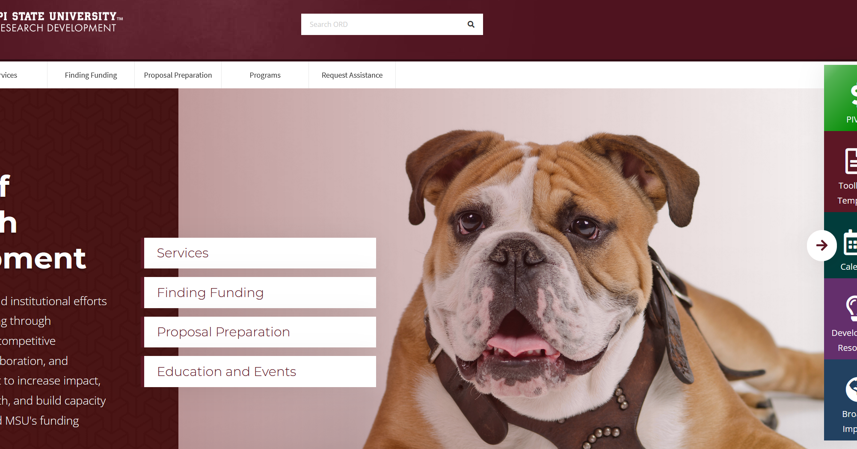

Slide 27
Your Broader Impacts Identity

Slide 28
Starting Point…
Everyone who does research has a RESEARCH IDENTITY
This is your footprint, your unique identity in the research landscape based on your individual contributions to your field
It shapes the choices you make, the collaborations you seek out, the grants you target, the journals in which you seek to publish, etc.
It is dynamic
It is (or will someday be) your research legacy
Whether consciously, or not, you spend a lot of time thinking about your RESEARCH IDENTITY

Slide 29
Building your BI Identity
You
Field
Capacity
Society
Impact sweet spot!
What would I LOVE to do?
What CAN I Do?
What SHOULD I do?

Slide 30
Building your BI Identity – What is your identity?
Craft a 3-4 sentence “Impact Identity and Goals” statement
You can frame it as follows: If I am successful in my BI efforts over the next 10 year, what will my biosketch say about the impact my work has had on society? Address questions such as:
Who are you, what impact can your work have?
What change do you want to see as a result of your work and why?
Who is (are) your audience(s) or beneficiaries?
What are your preferred media/processes to realize desired impacts?
You
Field
Capacity
Society
Remember: This is not a contract…it’s a potential roadmap!
Notes:
5 minutes
If you have an established your early emotions and motivators and how your thinking has evolved over time. Go ahead and discuss these questions with your partners. Focus on growth and long-term commitments and collaborate with your partner to craft an impact identity goal statement.
Share your partners compelling story
15 minutes – then report out

Slide 31
Creating a BI Plan

Slide 32
The Broader Impacts Wizard provides prompts and questions to help with the design of your BI plans and activities.
A well-written BI section should include activities that are clearly described, have a well-justified rationale, demonstrate creativity or originality OR have a basis in established approaches
The proposer should have a well-organized strategy for accomplishment of clearly stated goals; establish the qualifications of those responsible for the activities; and demonstrate sufficient resource for support
A plan should be in place to document/assess results

Slide 33
Just as you prepare your “research plan” you should consider the same questions for your BI plan:
What do you want to do (impact outcome goal)?
Why do you want to do it?
What is your activity?
What audience(s) will it serve?
Will it serve people underrepresented in STEM?
What need(s) or niche(s) does it fill?
How will you do it?
What resources will you need to do it?
Who will do it? Who will help?
How will you know you’ve done it?
What is the timeline?

Slide 34
Broader Impacts Statements for the Reviewers
The proposed activity benefits society at-large (or a segment thereof) by…..
Societal benefits of the proposed activities include…..(education, infrastructure, well-being, etc.)
Evidence of the need for this intervention among this sector/audience/sector is….
(insert underrepresented population targeted, ex: women) are empowered through…..
Expected outcomes of the proposed work will enable (insert underrepresented population targeted) to….
Locally, research infrastructure is impacted through improvements to…..
The results of this work reach beyond (local/discipline-specific, etc.) implications to impact……
The population(s) of stakeholders most impacted by this work is/are…..
The project expands the capacity of XXX to reach/impact……
While this work will certainly impact the MSU target service area, as evidenced by….., a broader segment of society is impacted due to……

Slide 35
We are here
to help!
development@ord.msstate.edu

